Slide 1
MEDI-CAPS UNIVERSITY DEPARTMENT OF COMPUTER SCIENCE AND ENGINEERING VISUAL ASSISTANT FOR VISUALLY IMPAIRED INDIVIDUALS MAJOR PROJECT
TEAM MEMBERS :
EN18CS301072 CHIRAYU YADAV
EN18CS301093 HANY JAGWANI
EN18CS301110 ISHIKA RAJAWAT

Slide 2
INTRODUCTION
One of the primary goals of image-based learning is to understand and differentiate among various scenic descriptions of common objects of interest. This task can be subdivided into a number of subtasks – bounding box creation, object localization, attribute determination, and relationship establishment. The images of various objects can be broadly classified into Iconic and Scenic Views. The Iconic approach assumes the presence of a single object with clear boundaries and separation edges. But, the iconic view is too simple to accommodate real-life situations, wherein images are seldom iconic but involves a large number of intertwined objects in a small space. In order to detect objects of interest, image segmentation and context mining should be applied to filter out points of interest. Most of the existing systems perform well under these iconic views but achieve lower accuracy in scenic instances.

Slide 3
INTRODUCTION
Globally, the number of people of all ages visually impaired is estimated to be 285 million, of whom 39 million are blind. Although technology has grown leaps and bounds, the accessibility, especially that of the internet for differently-abled people is still far-fetched. These individuals have trouble running rudimentary daily errands due to low visual capacity. We aim to utilize the hearing capacity of these individuals to provide them with Real-Time scenic descriptions using object detection and scene labeling.

Slide 4
PROBLEM STATEMENT
We aim to develop a utility for visually-impaired individuals using an objection detection model and IoT.
We propose to install the camera on the walking cane of a blind individual so that objects in front could be detected.
We aim to use an Object detection model to detect the objects and the response will be pronounced to the individual from the mobile app via an earpiece.

Slide 5
OBJECTIVES OF PROJECT
Develop a model that identifies general objects from an image.
Develop a mobile application that captures an image and relays the scenic description from the app via the earpiece.
Build an intermediate link between the app and model that helps in generating queries and reading out responses.

Slide 6
RELATED WORK
You Only Look Once : Unified, Real-Time Object Detection (Joseph Redmon, Santosh Divalla, Ross Girshick,) [1] This paper presents YOLO as a new approach to object detection. They have framed object detection as a regression problem to spatially separated bounding boxes and associated class probabilities. Fast YOLO, processes an astounding 155 frames per second while still achieving double the mAP of other real-time detectors. Compared to state-of-the-art detection systems, YOLO makes more localization errors but is less likely to predict false positives on background. Finally, YOLO learns very general representations of objects. It outperforms other detection methods, including DPM and R-CNN, when generalizing from natural images to other domains like artwork.
Incremental Few-Shot Object Detection (Juan-Manuel, Perez-Rua, Xiatian Zhu, Timothy Hospedales, Tao Xiang) [2] Despite the success of deep convolutional neural networks

Slide 7
RELATED WORK
(CNNs) in object detection, for almost all the current models a lengthy process of numerous iterations in a batch is used to train them .Here in the current setting, all the target classes with a large number of training samples interpreted with training data are familiar and for training purposes all the training images are used.The potential for these methods to accommodate new classes online and grow is restricted severely by the interpretation cost and training complexity.
Microsoft COCO: Common Objects in Context(Tsung-Yi Lin, Michael Maire, Serge Belongie, Lubomir Bourdev, Ross Girshick, James Hays, Pietro Perona, Deva Ramanan, C. Lawrence Zitnik, Piotr Dollar [3] This paper has been written as a guide to the novel COCO Dataset created for Object detection and classification. It mainly focuses on the non-iconic or scenic views of images, pointing out the difficulties encountered when detecting scenic views

Slide 8
PROPOSED METHOD
The Project Architecture will comprise various dependent components implemented as stand-alone modules. We will adopt a client-server architecture, wherein the Server is a remote entity running on a local machine. The Client Application will be implemented as a mobile application that is connected to the camera device through a wireless network either using Bluetooth, WiFi, or other wireless transmission protocols. The only requirement is sufficient bandwidth and low latency. The mobile application will send a request to the mirror site which, in turn, will forward it to the local server. The local server, running a YOLOv3 model, will detect objects within the input image and create a list of objects found. This list will finally get converted into a string and will be sent as a response to the mirror site, which, redirects the response to the client application.

Slide 9
PROPOSED METHOD
The client application using text-to-speech functionality will convert this string into audio that is fed into the earpiece of the visually-impaired individual. For simplicity, the entire image will be divided into 9 different zones, viz., Center, Top Left, Bottom Right. The model will also predict the zone of each object detected using the bounding-box location returned by the YOLO model.

Slide 10
SCOPE OF THE PROPOSED WORK
At present, the application will detect objects and pronounce them only in the English language. It can be expanded and made available in most of the daily used languages thus people from all parts of the world can access the web without any issue.
A web application can also be developed that would perform the same task without having to download the mobile application.

Slide 11
FEASIBILITY STUDY
Technical Feasibility: It includes finding out technologies for the project, both hardware, and software. The mobile phone must have a working camera to capture the image and a working earpiece so that the user can listen to the instructions. Good internet connection is also a must on the mobile phone.
Operational Feasibility : It is the ease and simplicity of operation of proposed system. System does not require any special skill set for users to operate it. In fact, it is designed to be used easily for visually impaired individual.
This project is technically feasible with no external hardware requirements. Also it is simple in operation and does not cost training or repairs. Overall feasibility study of the project reveals that the goals of the proposed system are achievable.

Slide 12
USER REQUIREMENTS
User need to click the photo of the surrounding.

Slide 13
SOFTWARE REQUIREMENTS
Python
Dart
Flutter
Flask
CV2
Ngrok

Slide 14
HARDWARE REQUIREMENTS
Memory(RAM) : Minimum 1GB: Recommended 4GB or more.
Minimum 100mb space required.
High resolution camera , earpiece/speaker.

Slide 15
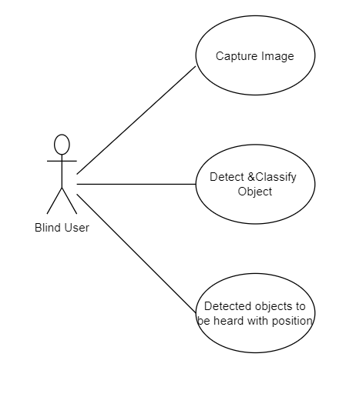
USE CASE DIAGRAM

Slide 16
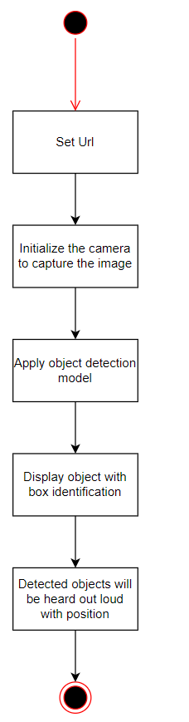
ACTIVITY DIAGRAM

Slide 17
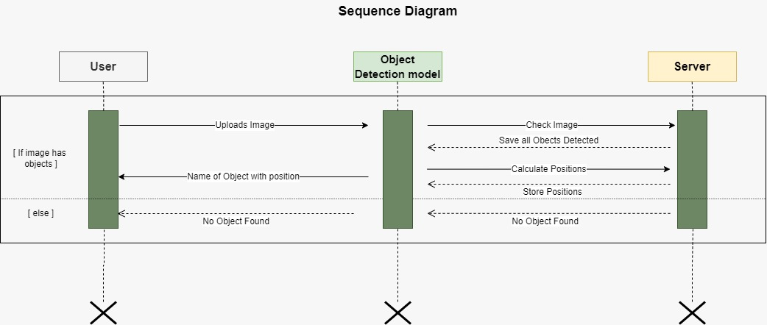
SEQUENCE DIAGRAM

Slide 18
LIMITATIONS OF WORK
The system cannot recognize text such as signboards.
It can only identify basic objects such as cars, humans, etc.

Slide 19
FUNCTIONAL REQUIREMENTS
INPUT: Capture the image.
OUTPUT: Objects detected by the system will be pronounced to user via earpiece.

Slide 20
NON-FUNCTIONAL REQUIREMENTS
Portability and compatibility: The software can only work on android.
Security: No authorization required.
Performance: The system should respond within 5 seconds.
Availability: Our system can be accessed 24*7 with a good internet connection.
Usability: The system should have a User-friendly interface.

Slide 21
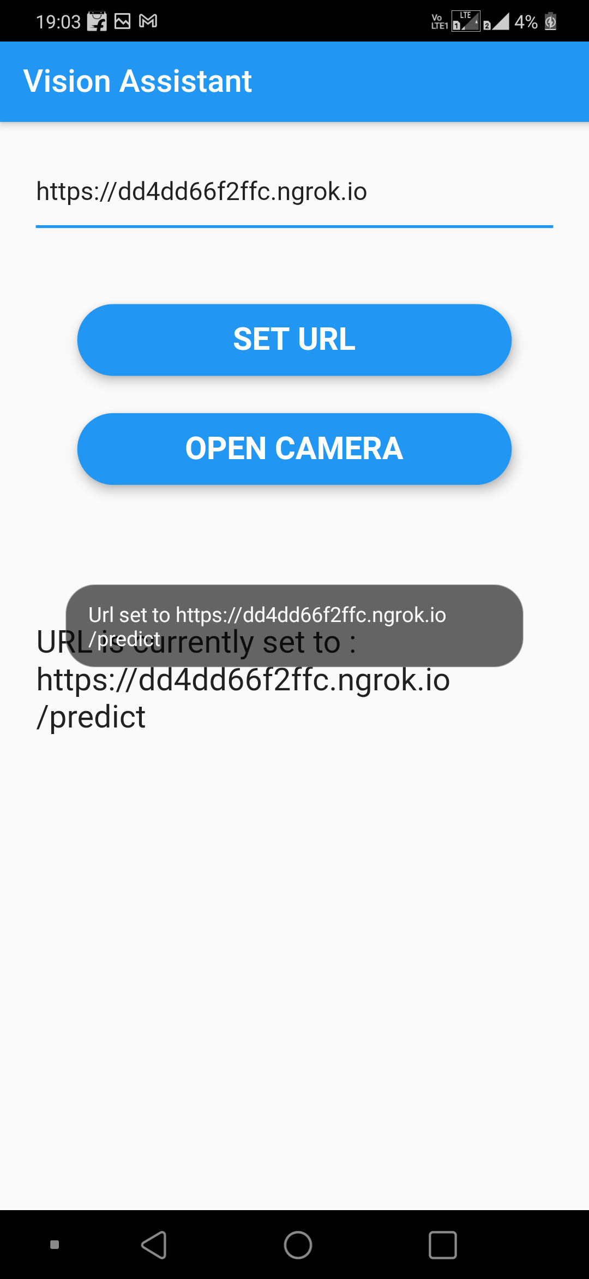
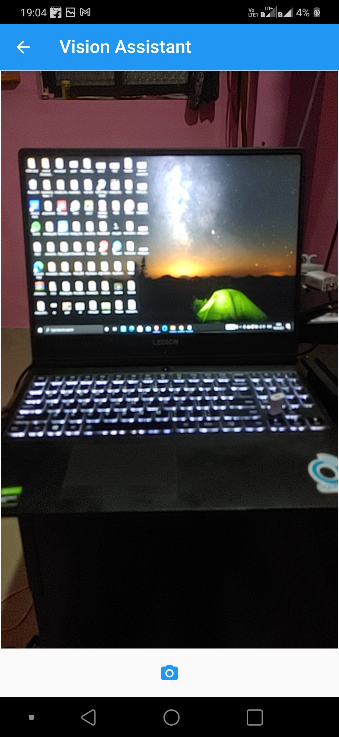
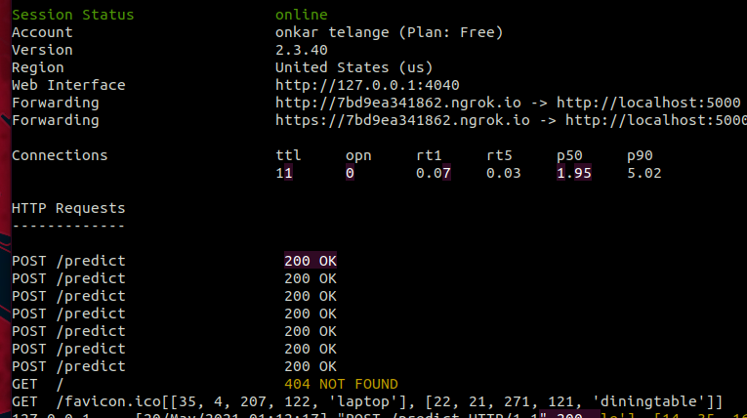
RESULT AND DISCUSSIONS

Slide 22
RESULT AND DISCUSSIONS
The url displayed on the terminal window is entered in the mobile application. After setting the url a picture is clicked. The name of the items will be heard aloud and will also be displayed on the terminal window along with its position. It can be seen in the figure below.

Slide 23
REFERENCES
[1] Redmon, Joseph, et al. ”You only look once: Unified, real-time object detection.” Proceedings of the IEEE conference on computer vision and pattern recognition. 2016.
[2] Perez-Rua, Juan-Manuel, et al. ”Incremental few-shot object detection.” Proceedings of the IEEE/CVF Conference on Computer Vision and Pattern Recognition. 2020.
[3] Lin, Tsung-Yi, et al. ”Microsoft coco: Common objects in context.” European conference on computer vision. Springer, Cham, 2014.

